Slide 1
Working with arrays

Slide 2
Arrays
Arrays are probably the most used data structure in JS
That’s the reason for many methods and functionalities we can do with arrays
Previously we learned how to use simple looping and simple methods
Now we will cover more specific ones

Slide 3


Methods - Slice
Slice – we will get new array starting from some index of beginning array:
As result we get: c, d, e
As result we get: c, d
If we call arr.slice() without input parameters, then we can get the copy of the whole array.
Another way to get the copy is to use this:

Slide 4

Methods - Splice
Pay attention this is not the same as the previous method!
Splice will change the original array, while slice will make the copy array.
We use Splice in similar way, just pay attention that original array will be changed:
See what you get as result in log, and see what arr looks like.

Slide 5

Methods - reverse
This method will change the array by reversing the order of elements.
Original array will be changed as result.
Guess what you will get as a result and guess what arr would look like

Slide 6



Methods – concat and join
Concat will join two arrays to one:
Check what happens when you use this:
Join will make the result string putting these letters together with some rule, for example to add ‘-’ between them

Slide 7
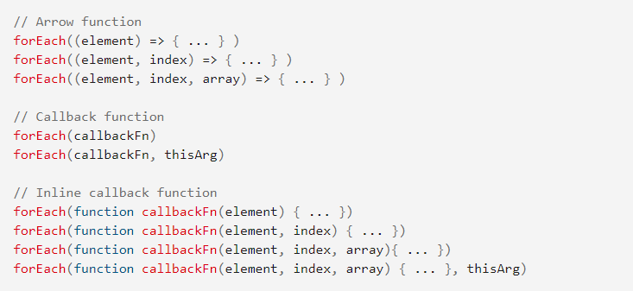
Looping - forEach
For and While we already covered
Here is the list of the possible ways to use it:

Slide 8
Let’s check forEach online
Here we can check some info with few examples:
https://developer.mozilla.org/en-US/docs/Web/JavaScript/Reference/Global_Objects/Array/forEach
And then let’s try to make some examples ourselves

Slide 9
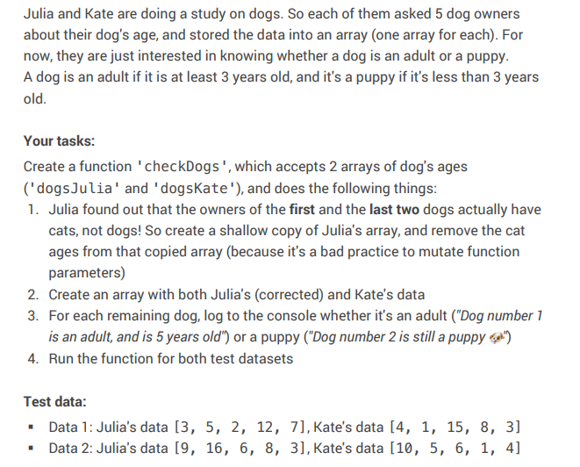
Code Challenge 1

Slide 10
Transforming arrays – 3 ways
Map
Filter
Reduce

Slide 11
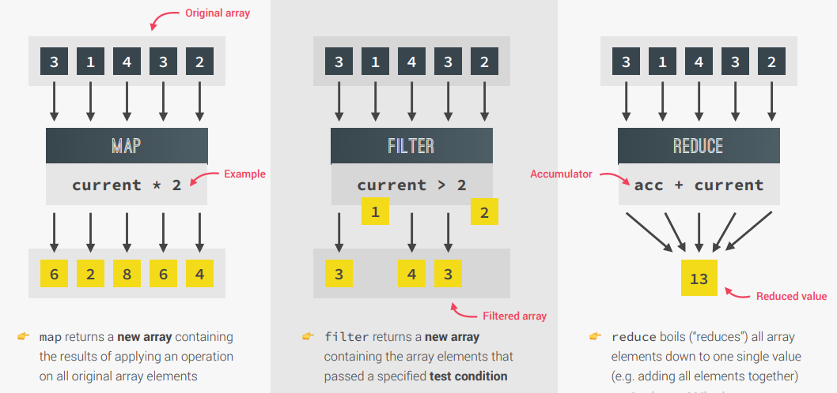
Transforming arrays – 3 ways

Slide 12

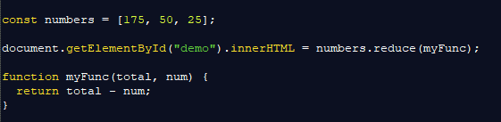
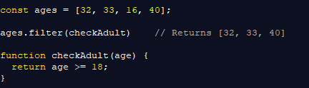
Let’s try them
We will now try to use all three of these methods to see how it actually works.
All of them could be very helpful for solving some problems

Slide 13
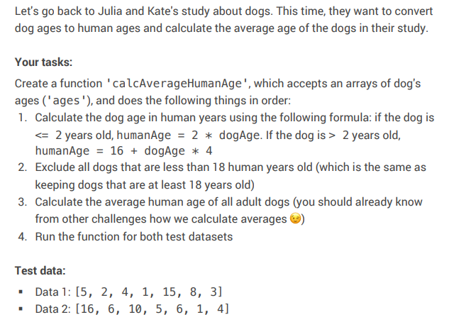
Code Challenge 2

Slide 14
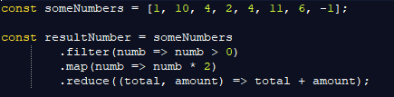
Method Chaining
This is the name of the situation when we have situation like this:

Slide 15
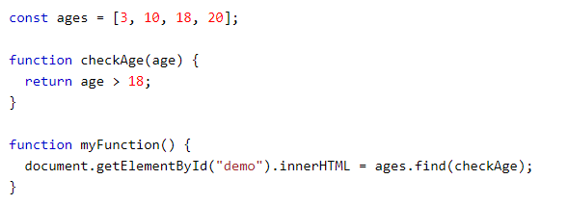
Just short notice - FIND
Before finishing the class, we can check the example for Find method
Find will look in the array, and find the data that is in accordance with function we provide.
For more clear understanding, see the example:

Slide 16
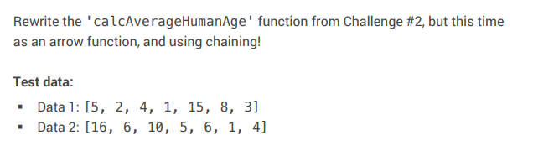
Homework
After the homework slide, there is another one where you can see all the useful commands for manipulating arrays

Slide 17
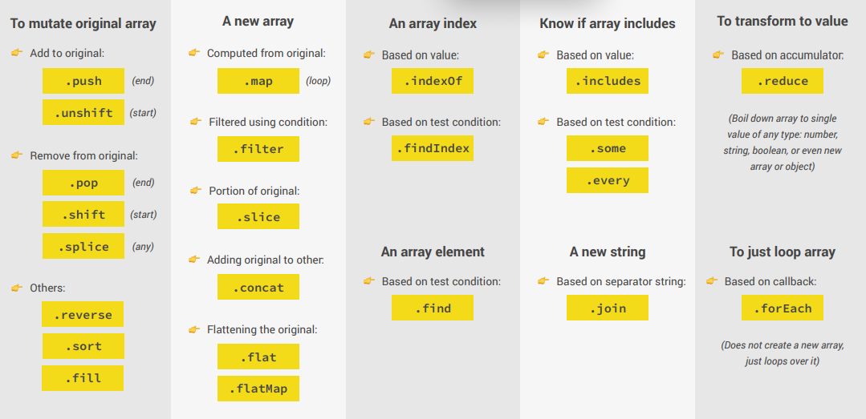
List of array methods to use

